Slide 1

Unveiling Customer Shopping Behavior
This project analyzes 3,900 customer purchases to uncover spending patterns, preferences, and subscription behavior. Our goal is to guide strategic business decisions with data-driven insights.

Slide 2

Project Overview
Data-Driven Insights
Strategic Decisions
Analyze transactional data to understand customer spending patterns.
Inform business strategies based on customer segments and product preferences.
Key Areas
Focus on spending, segmentation, product choices, and subscription impact.

Slide 3
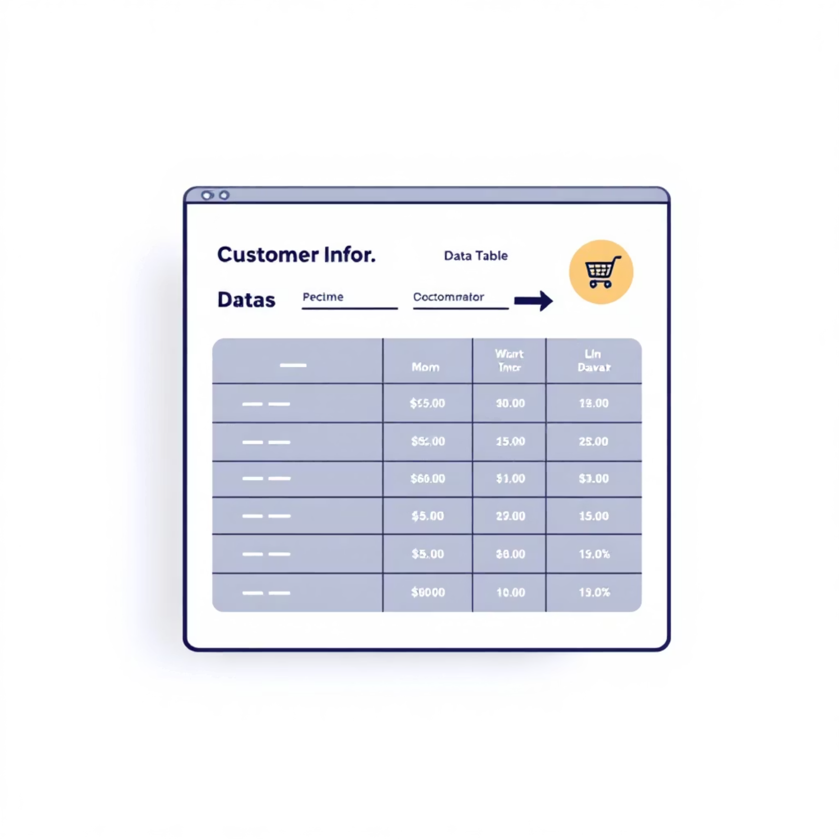

Dataset Summary: 3,900 Purchases
Our dataset comprises 3,900 rows and 18 columns, capturing a comprehensive view of customer interactions.
Customer Demographics: Age, Gender, Location, Subscription Status.
Purchase Details: Item, Category, Amount, Season, Size, Color.
Shopping Behavior: Discount, Promo Code, Previous Purchases, Frequency, Review Rating, Shipping Type.
Missing Data: 37 values in the Review Rating column were imputed using the median rating per product category.

Slide 4
Exploratory Data Analysis with Python
01
02
Data Preparation
Data Cleaning
Loaded dataset with pandas, checked structure and summary statistics.
Handled null values in 'Review Rating' by imputing with median per category.
03
04
Standardization
Feature Engineering
Renamed columns to snake case for readability and consistency.
Created 'age_group' and 'purchase_frequency_days' columns.
05
06
Data Consistency
Database Integration
Verified and dropped redundant 'promo_code_used' column.
Loaded cleaned data into PostgreSQL for SQL analysis.

Slide 5
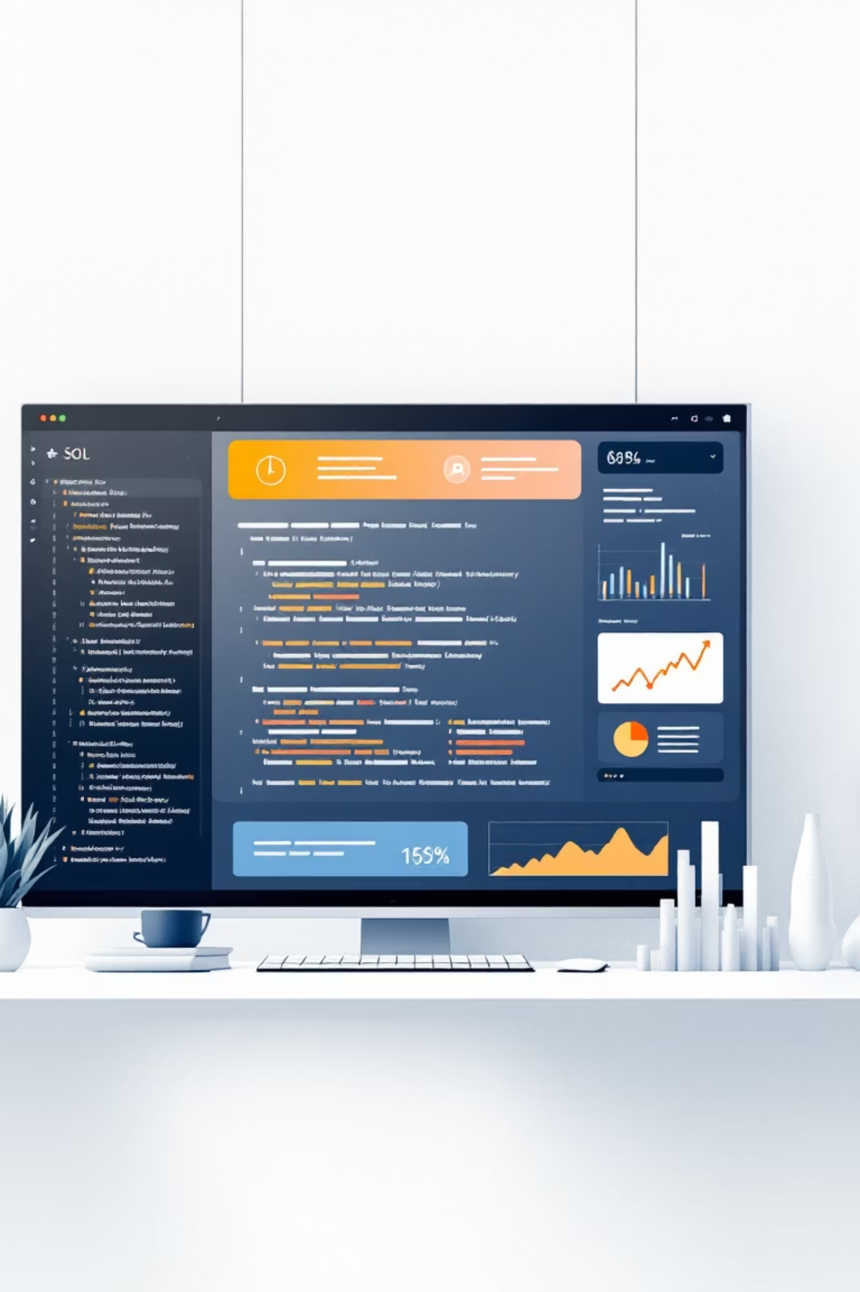

SQL Analysis: Key Business Questions
Structured analysis in Microsoft SQL addressed critical business questions to derive actionable insights.
Revenue by Gender
Top 5 Products
Compared total revenue from male vs. female customers.
Identified products with the highest average review ratings.
Shipping Comparison
Analyzed average purchase amounts for Standard vs. Express shipping.

Slide 6
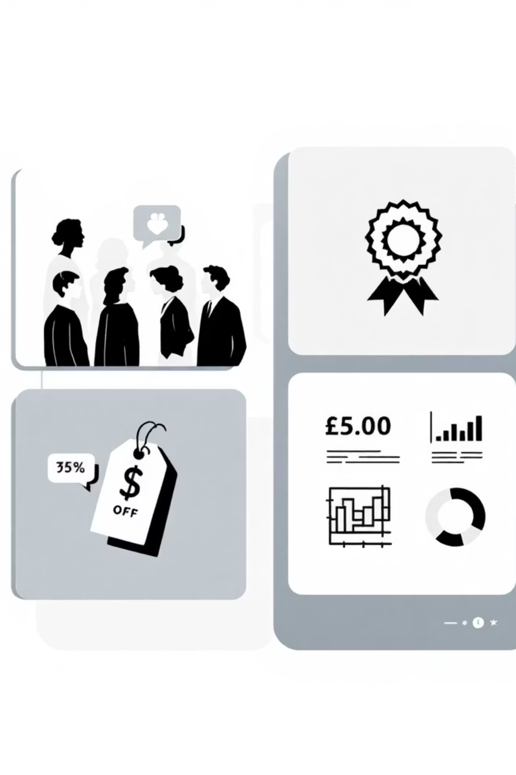
SQL Analysis: Customer & Product Insights
1
High-Spending Discount Users
Customers using discounts but spending above average.
2
Subscribers vs. Non-Subscribers
Compared average spend and total revenue across subscription statuses.
3
Discount-Dependent Products
Top 5 products with the highest percentage of discounted purchases.
4
Customer Segmentation
Classified customers into New, Returning, and Loyal segments.

Slide 7
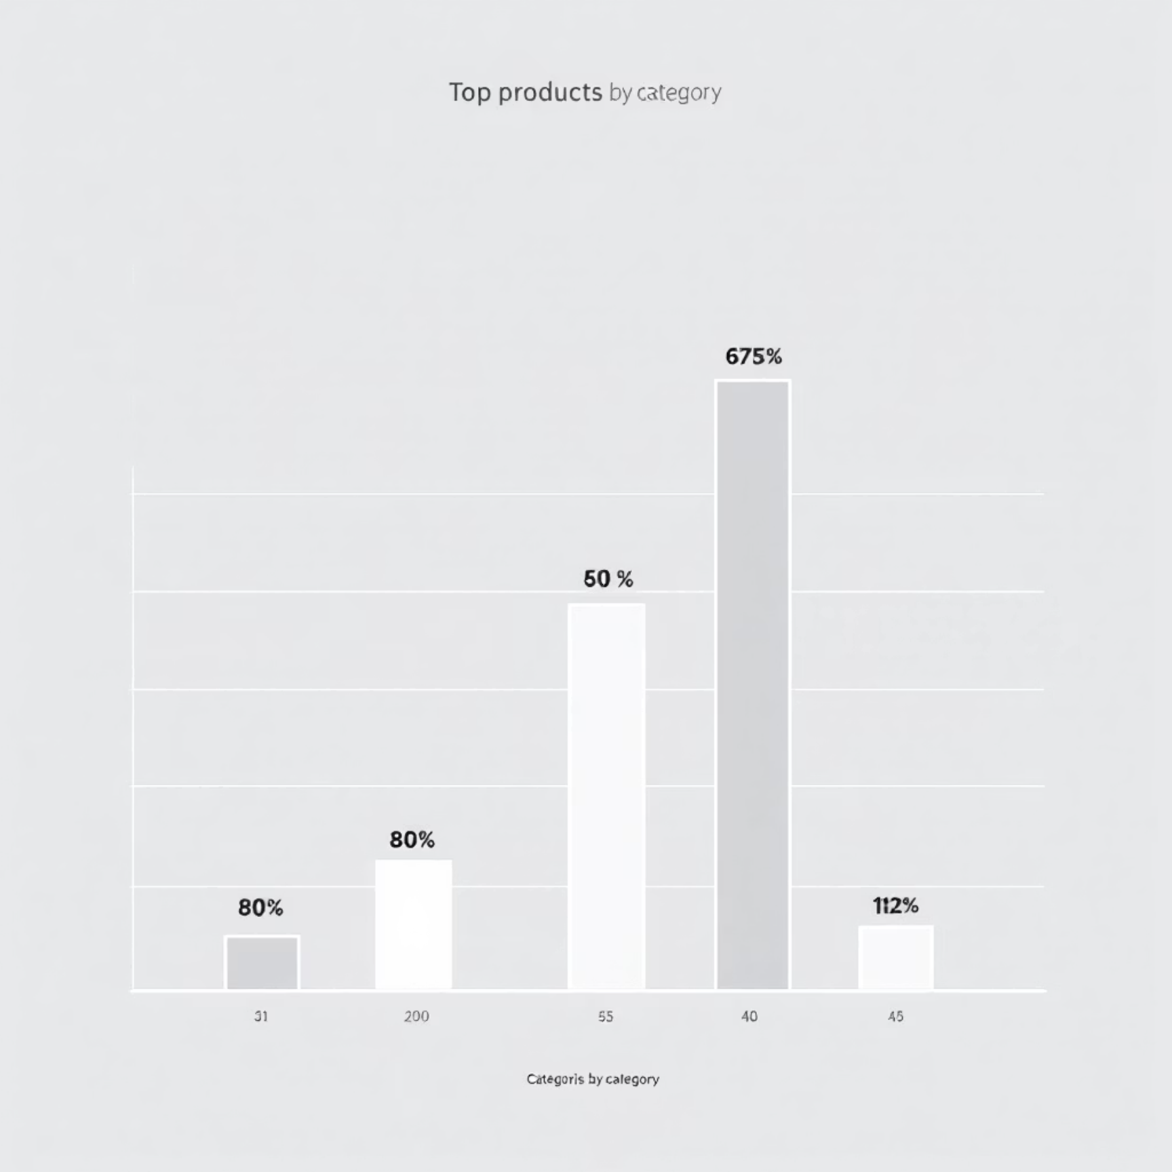
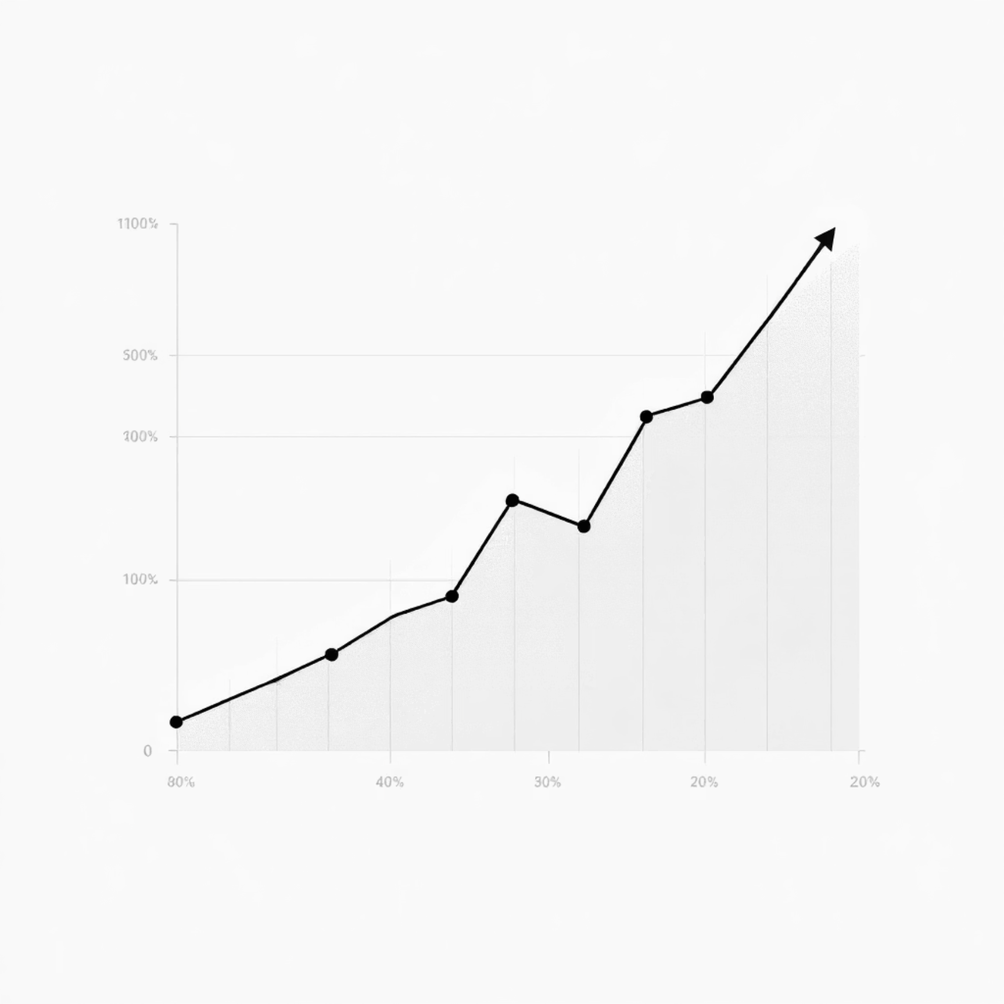
SQL Analysis: Purchase Patterns
Top 3 Products per Category
Repeat Buyers & Subscriptions
Identified the most purchased products within each category, revealing key consumer preferences.
Investigated if customers with more than 5 purchases are more likely to subscribe, linking loyalty to subscription potential.

Slide 8
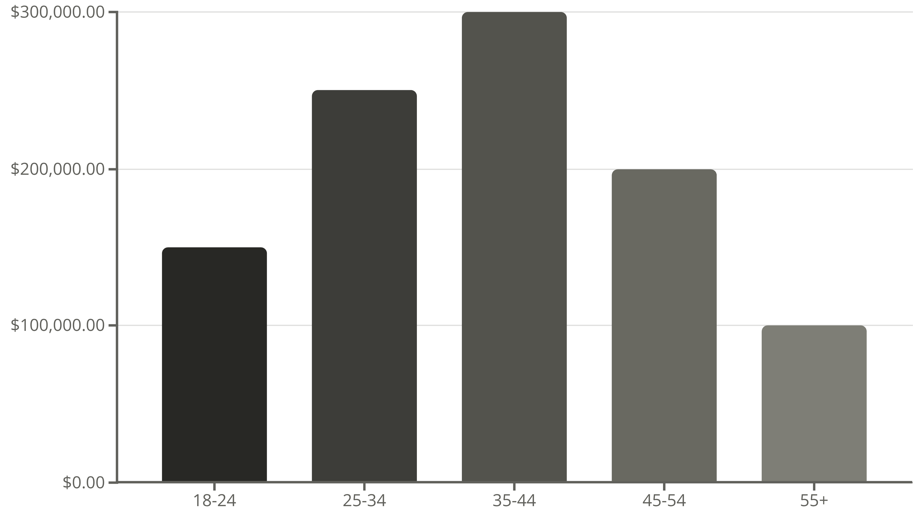
SQL Analysis: Revenue by Age Group
Understanding the revenue contribution from different age groups helps in targeted marketing and product development.
The analysis shows that the 35-44 age group contributes the most to total revenue.

Slide 9
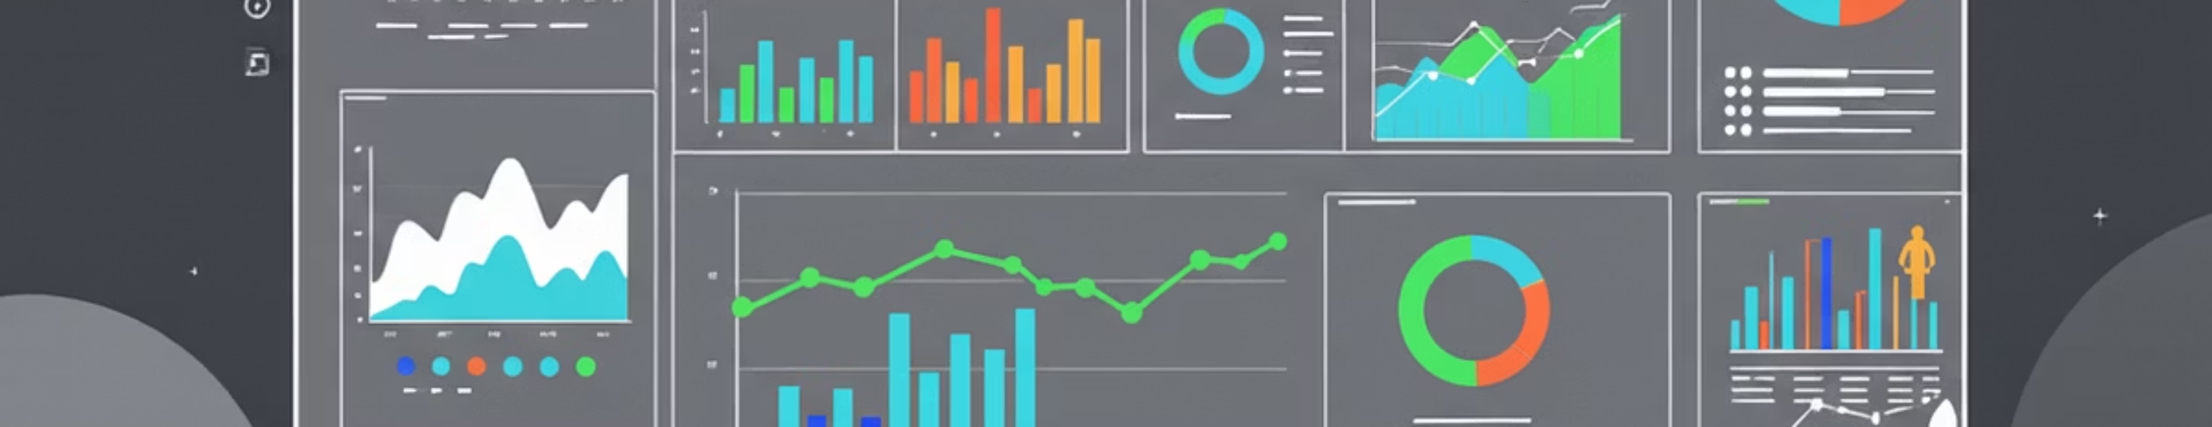
Interactive Dashboard in Power BI
A dynamic Power BI dashboard was created to visualize key insights and metrics at a glance, enabling easy exploration of the data.

Slide 10





Business Recommendations
Boost Subscriptions
Promote exclusive benefits to increase subscriber base.
Customer Loyalty Programs
Reward repeat buyers to foster loyalty and retention.
Review Discount Policy
Balance sales boosts with maintaining profit margins.
Product Positioning
Highlight top-rated and best-selling items in marketing campaigns.
Targeted Marketing
Focus efforts on high-revenue age groups and express-shipping users.

